Slide 1

Track Classification of Ship Data Using Time-Series Analysis Library Fb
Presenter: Amit Kumar

Slide 2


Content
1. Introduction to Time-Series Analysis
2. Understanding Ship Data
3. Application of Time-Series Analysis in Ship Tracking
4. Case Studies and Examples
5. Future Implications and Opportunities

Slide 3

Section 1
Introduction to Time-Series Analysis

Slide 4



What is Time-Series Analysis?
Definition and Scope
Importance in Data Analysis
Time-series analysis involves studying the patterns and trends in data points collected, stored, and analyzed over time. It provides valuable insights into the behavior and characteristics of dynamic systems.
Time-series analysis is crucial for identifying temporal patterns, forecasting future trends, and understanding the underlying dynamics of various phenomena.

Slide 5

Key Concepts in Time-Series Analysis
Data Components
Time-series data consists of four primary components: trend, seasonality, cyclic behavior, and irregular fluctuations. Understanding these components is essential for accurate analysis and interpretation.
Analytical Techniques
Various methods such as moving averages, exponential smoothing, and autoregressive integrated moving average (ARIMA) models are commonly used in time-series analysis to extract meaningful insights from data.

Slide 6



Applications of Time-Series Analysis
01
02
Financial Forecasting
Demand Forecasting
Time-series analysis is widely used in financial markets for predicting stock prices, currency exchange rates, and other economic indicators.
Businesses utilize time-series analysis to forecast customer demand for products and services, optimizing inventory management and production planning.

Slide 7

Benefits and Limitations of Time-Series Analysis
Benefits
Time-series analysis enables the identification of long-term trends, seasonality patterns, and irregular fluctuations, facilitating informed decision-making and strategic planning.
Limitations
Challenges in handling outliers, missing data, and complex non-linear relationships can pose limitations in the accurate analysis of time-series data.

Slide 8
Section 2
Understanding Ship Data

Slide 9


Overview of Ship Data
Types of Ship Data
Data Collection Methods
Ship data encompasses various parameters such as location coordinates, speed, heading, and environmental conditions, providing comprehensive insights into maritime activities.
Ship data is collected through AIS (Automatic Identification System), radar systems, satellite imagery, and other monitoring technologies.

Slide 10

Significance of Ship Data Analysis
Maritime Surveillance
Analyzing ship data is crucial for maritime surveillance, border security, and monitoring illegal activities such as smuggling and piracy.
Environmental Monitoring
Ship data analysis aids in assessing the environmental impact of maritime operations, including pollution and marine conservation efforts.

Slide 11


FBprophet Workflow
Data Preprocessing
Model Training
Forecast Visualization
FBprophet simplifies time-series forecasting by handling missing data and outliers, reducing the need for extensive data preprocessing.
FBprophet's intuitive interface allows users to train forecasting models with minimal effort, making it accessible to analysts and business users.
FBprophet provides tools for visualizing forecasted trends, seasonality, and uncertainty, enabling clear and concise communication of predictions.

Slide 12



Introduction to LSTM Model
Long Short-Term Memory
Sequential Data Processing
Applications in Classification
LSTM is a type of recurrent neural network (RNN) capable of learning long-term dependencies, making it suitable for time-series data analysis.
LSTM excels in processing sequential data, enabling it to capture complex patterns and relationships in time-series datasets.
LSTM models are widely used for sequence classification tasks, including speech recognition, sentiment analysis, and time-series forecasting.

Slide 13
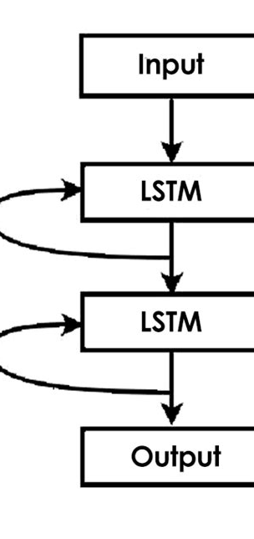
LSTM Model Architecture
Memory Cells
LSTM models are built with memory cells that can maintain and update information over time, allowing them to retain relevant context for classification tasks.
Temporal Learning
LSTM's ability to learn from sequential data enables it to capture temporal dependencies and make accurate predictions based on historical patterns.
Feature Representation
LSTM models automatically learn feature representations from time-series data, reducing the need for manual feature engineering.

Slide 14
Challenges in Ship Data Analysis
01
02
Data Volume and Velocity
Data Quality and Integrity
The sheer volume and velocity of ship data pose challenges in processing, storing, and analyzing the information in real-time.
Ensuring the accuracy and integrity of ship data is essential for reliable analysis and decision-making.

Slide 15

Data Preprocessing for Ship Tracking
Cleaning and Filtering
Preprocessing ship data involves cleaning and filtering out noise, errors, and redundant information to enhance the quality and reliability of the dataset.
Normalization and Standardization
Standardizing ship data through normalization and scaling prepares it for effective time-series analysis and modeling.

Slide 16
Section 3
Application of Time-Series Analysis in Ship Tracking

Slide 17


Time-Series Analysis for Ship Movement Patterns
Trajectory Analysis
Anomaly Detection
Time-series analysis enables the identification of ship movement patterns, including route optimization, port visits, and deviations from standard routes.
Detecting anomalies in ship movement data is crucial for identifying suspicious activities and ensuring maritime security.

Slide 18

Forecasting Ship Traffic and Congestion
Traffic Flow Analysis
Time-series analysis can forecast ship traffic density, predict congestion hotspots, and optimize maritime traffic management.
Port Activity Forecasting
Anticipating port activity based on historical ship data facilitates efficient resource allocation and scheduling.

Slide 19
Predictive Maintenance for Vessels
01
02
Engine Performance Analysis
Component Failure Prediction
Time-series analysis aids in predicting engine performance degradation, facilitating proactive maintenance and minimizing downtime.
Identifying potential failures in ship components through time-series analysis enables preemptive maintenance and cost savings.

Slide 20

Real-Time Monitoring and Alert Systems
Environmental Monitoring
Time-series analysis of ship data supports real-time environmental monitoring, including oil spill detection and marine pollution alerts.
Security and Safety Alerts
Implementing alert systems based on time-series analysis enhances maritime security and safety measures.

Slide 21
Section 4
Case Studies and Examples

Slide 22


Case Study: Optimizing Shipping Routes
Data Analysis Approach
Quantifiable Benefits
This case study demonstrates how time-series analysis was used to optimize shipping routes, reduce fuel consumption, and minimize transit times.
The application of time-series analysis resulted in significant cost savings, improved operational efficiency, and reduced environmental impact.

Slide 23
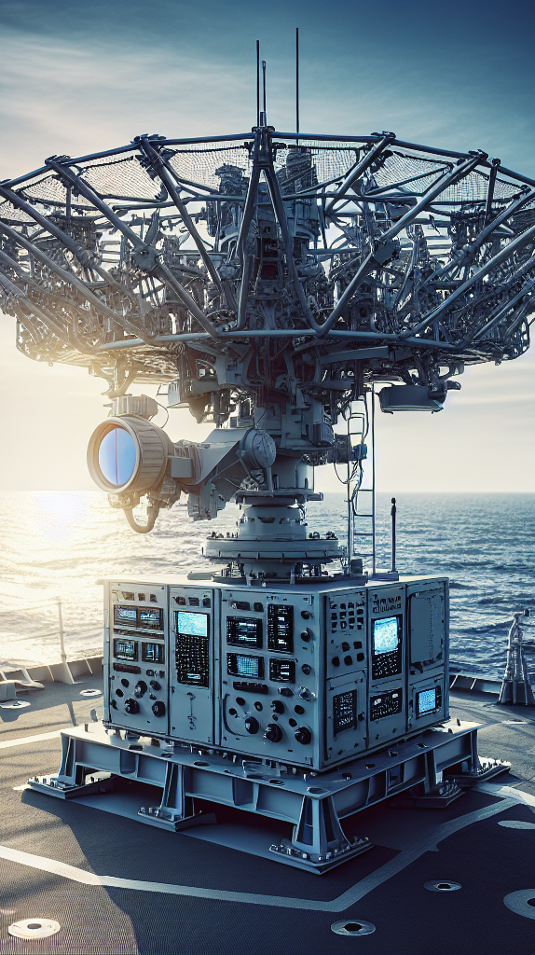
Example: Anomaly Detection in Maritime Activities
Identification of Anomalies
This example showcases how time-series analysis was utilized to detect anomalous ship behaviors, leading to the prevention of illicit activities and enhanced maritime security.
Impact on Surveillance
The implementation of anomaly detection systems based on time-series analysis has significantly improved maritime surveillance capabilities.

Slide 24
Case Study: Predictive Maintenance for Marine Engines
01
02
Proactive Maintenance Strategy
Operational Efficiency
This case study outlines the implementation of predictive maintenance for marine engines using time-series analysis, resulting in reduced maintenance costs and enhanced vessel reliability.
The predictive maintenance approach led to improved operational uptime and minimized disruptions in maritime operations.

Slide 25

Example: Real-Time Environmental Monitoring
Environmental Impact Assessment
This example highlights the real-time environmental monitoring capabilities enabled by time-series analysis of ship data, facilitating rapid response to environmental incidents.
Sustainable Practices
The integration of real-time environmental monitoring has contributed to the adoption of sustainable maritime practices and compliance with environmental regulations.

Slide 26

Section 5
Future Implications and Opportunities

Slide 27

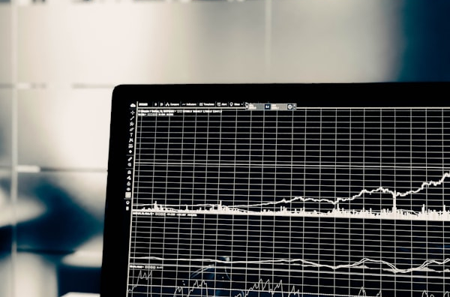
Advancements in Ship Data Analytics
Emerging Technologies
Integration with IoT
The future of ship data analytics involves leveraging advanced technologies such as machine learning, AI, and big data analytics for enhanced insights and predictive capabilities.
The integration of ship data analytics with IoT (Internet of Things) devices and sensors presents new opportunities for comprehensive maritime data analysis.

Slide 28

Educational and Research Prospects
Academic Programs
The growing significance of ship data analytics creates opportunities for educational programs and research initiatives focusing on maritime data science and analysis.
Industry Collaboration
Collaboration between academia and industry can drive innovation in ship data analytics, fostering practical applications and knowledge exchange.

Slide 29
Ethical and Regulatory Considerations
01
02
Data Privacy and Security
Regulatory Frameworks
As ship data analytics advances, ethical considerations regarding data privacy, security, and responsible use become increasingly important.
The development of regulatory frameworks for ship data analytics ensures ethical and lawful practices in maritime data analysis and surveillance.

Slide 30
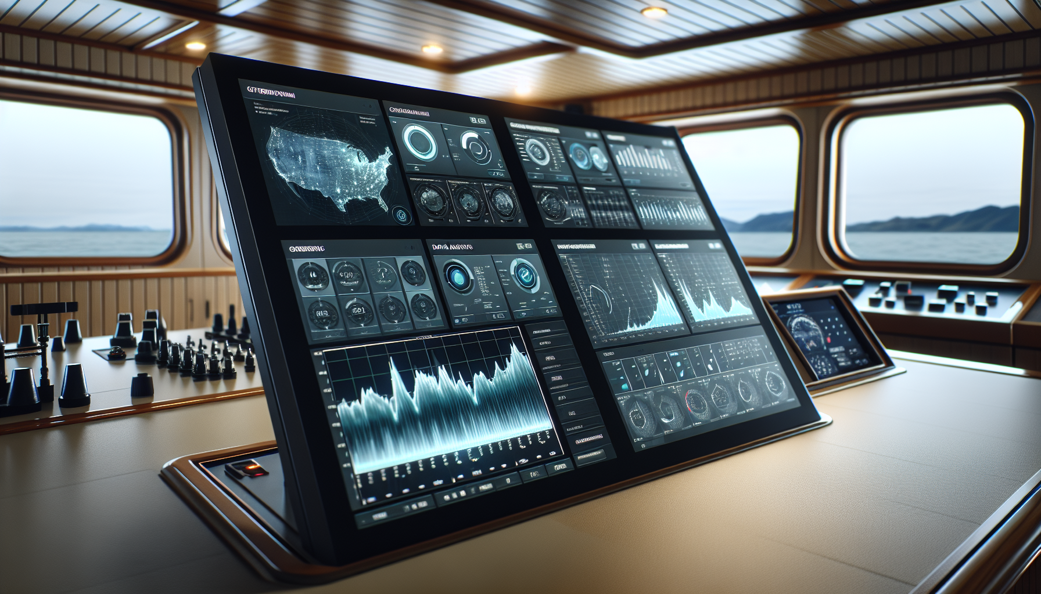
Future Outlook and Impact
Global Maritime Trends
The future of ship data analytics will influence global maritime trends, including sustainability, safety, security, and operational efficiency.
Student Engagement
Encouraging student engagement and interest in ship data analytics fosters the next generation of maritime data scientists and analysts.

Slide 31

Results: Overall Deviation
Quantifying Deviation
Implications for Analysis
Assessing the overall deviation in ship data analysis provides insights into the accuracy and reliability of time-series models.
Understanding overall deviation informs improvements in data preprocessing and model selection for enhanced ship tracking.

Slide 32

Efficiency of Prophet Models
Evaluation Metrics
Assessing the efficiency of Prophet models in ship data analysis involves evaluating forecasting accuracy, computational performance, and scalability.

